Slide 1

ANY+
SOLUTIONS
2018
MARKETING PROPOSAL
for Health in a Box
PRESENTED BY
MICHAEL PETERSON

Slide 2

ABOUT HEALTH IN A BOX
Health in a Box is a food delivery service of fresh, low-carb meals. They deliver breakfast, lunch and dinner meals in 5 cities.
ANY+
SOLUTIONS

Slide 3

CURRENT SITUATION
Health in a Box currently has 400 customers per week, which is below the projected 1,500.
ANY+
SOLUTIONS

Slide 4
50
PROPOSED GROWTH STRATEGY 1
40
30
Increase the number of cities served to 15. Let us tap more delivery service companies and provide convenient pick-up points for customers.
20
10
0
Item 1
Item 2
Item 3
Item 4
Item 5
ANY+
SOLUTIONS

Slide 5
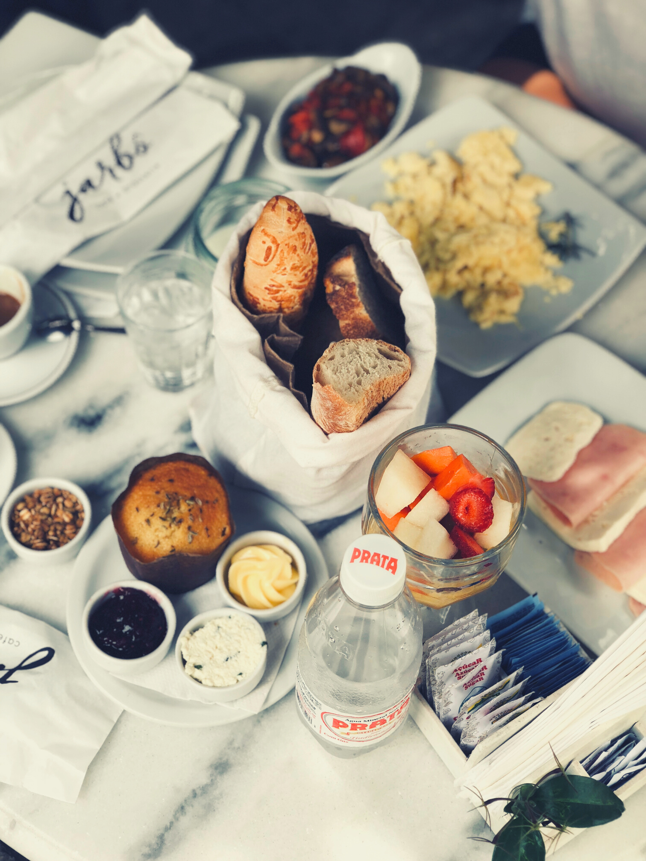
PROPOSED GROWTH STRATEGY 2
Since our current customers are young professionals, let us expand our target customers to home decision makers and people living in apartments.
ANY+
SOLUTIONS

Slide 6
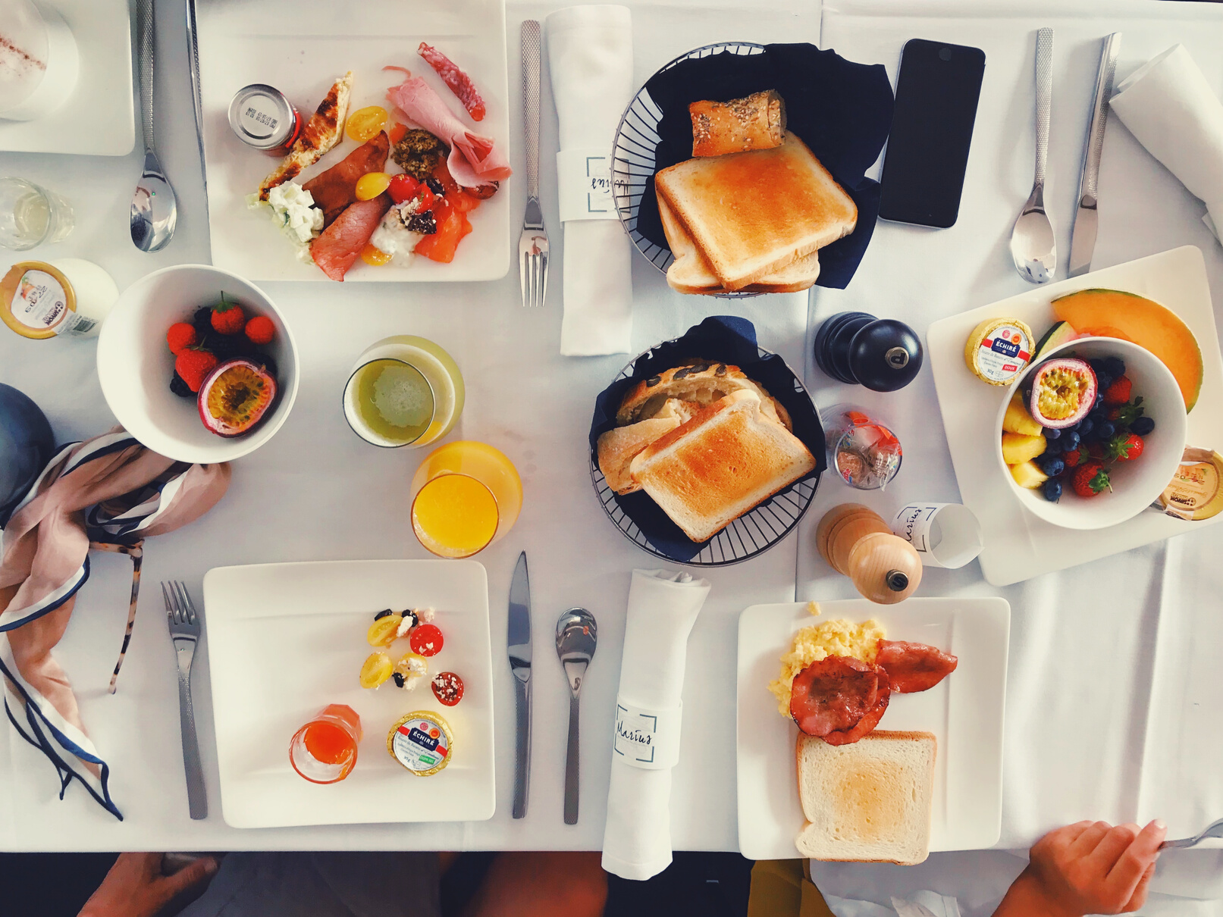
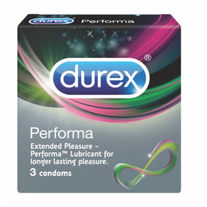
PROPOSED GROWTH STRATEGY 3
Create an online website and mobile app where orders will be received. This will be a great supplement to the phone-only method.
ANY+
SOLUTIONS

Slide 7

TIMELINE OF ACTIVITIES
Q1
Q2
Q3
Q4
Finalize additional delivery service companies & pick-up points
Create online and offline advertising materials
Launch website & app
Measurement
ANY+
SOLUTIONS

Slide 8

ADDITIONAL RECOMMENDATIONS
Improve customer service on social media & phone
Answer feedback received on website
Regularly update social media pages
ANY+
SOLUTIONS

Slide 9




ANY+ SOLUTIONS MARKETING TEAM
JULIUS MCPHEE
ANTHONY LAWSON
CHRISTELLE LOPEZ
JULIENNE LAWRENCE
ANY+
SOLUTIONS

Slide 10
ANY+
SOLUTIONS
THANK YOU FOR YOUR TIME!
FOR COMMENTS, PLEASE
CONTACT US AT 987-654-321 OR HELLO@REALLYGREATSITE.COM

